Slide 1

BBB-Working with PRU
Team Hindenburg
PRU Guide Online

Slide 2
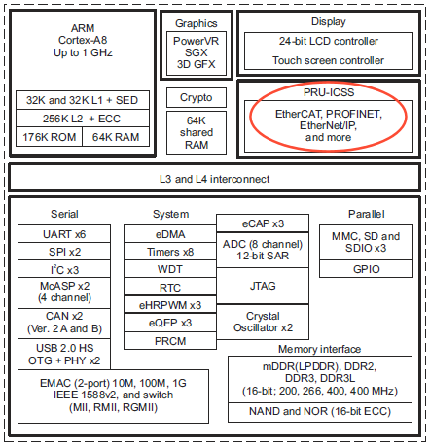
What is a PRU?
Notes:
BBB’s TI chip contains both the main ARM processor and two PRUs because Linux context switching makes real-time scheduling difficult in high-speed applications

Slide 3
Characteristics of the PRU
2 PRUs, independent, 32-bit microcontrollers
200 MHz (5 ns/cycle)
Interrupt Controller (more of an event handler)
8 kB Data RAM each
12 kB Shared RAM can be used for communications
No overhead on main ARM processor
25 Low latency Pins (tied to r30 and r31):
P8: (9 – probably useful for receiving PWM from receiver)
25, 26, 27, 28, 29, 30, 31, 41, 42
P9: (16 – probably useful for ultrasonic sensor IO)
11, 12, 20, 21, 27, 28, 29, 30, 39, 40, 41, 42, 43, 44, 45, 46
(Make sure HDMI is disabled)

Slide 4
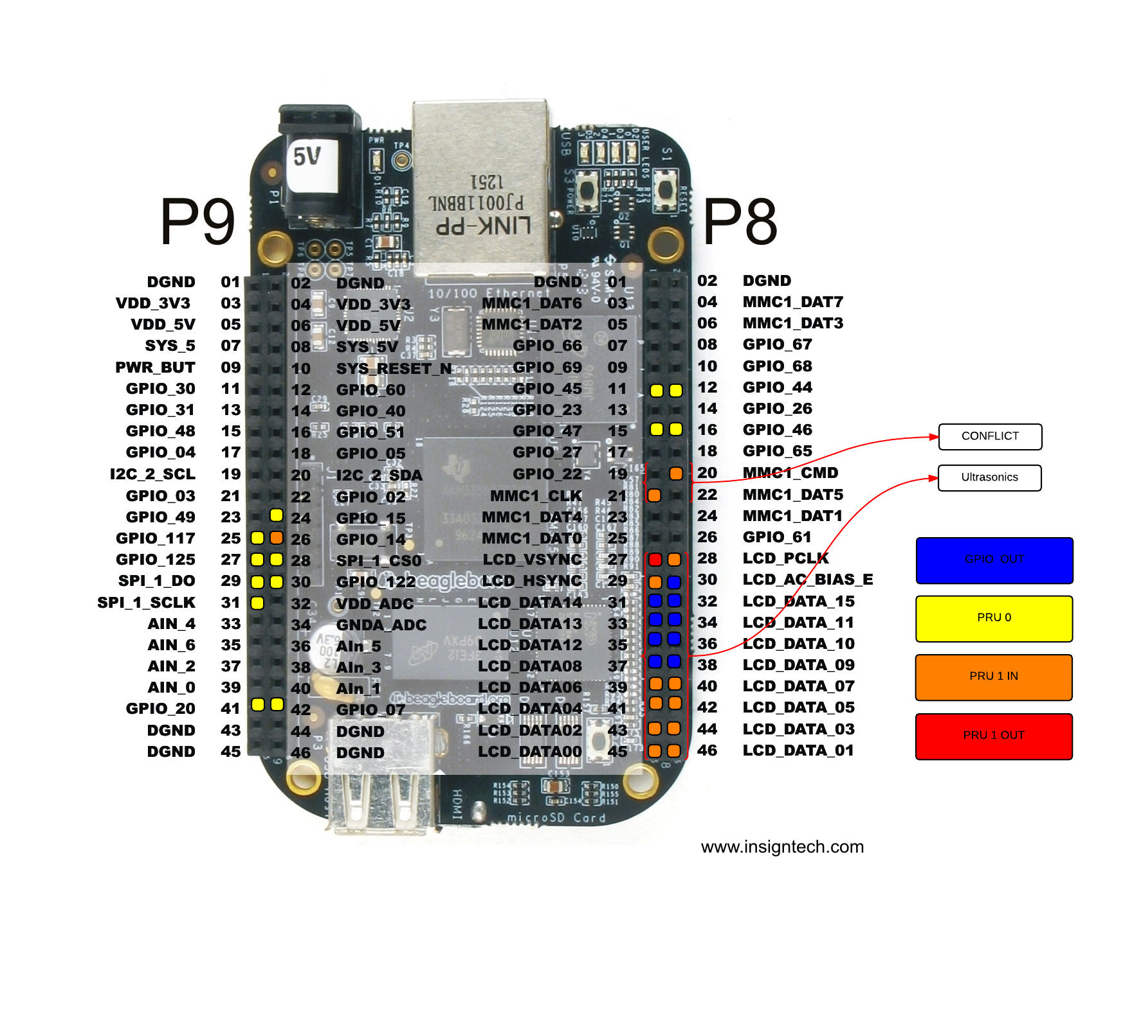
Characteristics of the PRU

Slide 5
Overview of Process
Linux
Loads the firmware
Manages resources (memory, CPU, etc.)
Controls execution (start, stop, etc.)
Sends/receives messages to share data
Synchronizes through events (interrupts)
These services are provided through a combination of remoteproc/rpmsg + virtio transport frameworks

Slide 6
Using the PRUs is painful…
Disadvantages
Even simple applications take a lot of work to set up
Steep learning curve
Security – no kernel in the PRU
Advantages
Speed – 2x 200MHz dedicated processors
Hard real-time execution
Offloading – completely independent of main linux kernel
Fast IO – PRU can access some pins directly, much faster than memory-mapped IO from main processor (40x)

Slide 7
What you need to get started
Install the toolchain
Code Composer Studio
Free, Linux & Windows
Must enable PRU support during installation
Can target PRU directly!
OR PRU Code Generation Tools
http://software-dl.ti.com/codegen/non-esd/downloads/beta.htm
.bin file addressing…
OR
Native Development on BBB
https://github.com/beagleboard/am335x_pru_package
new directory /usr/include/pruss/
Copy prussdrv.h and pruss_intc_mapping.h
(From am335x_pru_package-master/pru_sw/app_loader/include)
cd am335x_pru_package-master/pru_sw/app_loader/interface
CROSS_COMPILE= make
Creates libprussdrv.a, libprussdrvd.a, libprussdrvd.so and libprussdrv.so
Copy to /usr/lib
run ldconfig
cd am335x_pru_package-master/pru_sw/utils/pasm_source
Run source linuxbuild – creates pasm executeable ./
Copy pasm to /usr/bin
Keep the am335x_pru_package tree – has documentation & example code

Slide 8
Using PRUs – the Painful Way
SSH into BBB, run native
Install PRU assembler on BBB – covered above
Enable the PRU
Create the PRU Program
Create the Host-side program
Build and test
(Optional)
Update the device tree overlay to alter pin modes

Slide 9
Using PRUs – the Painful Way
SSH into BBB, run native
Install PRU assembler on BBB – covered above
Enable the PRU
Create the PRU Program
Create the Host-side program
Build and test
(Optional)
Update the device tree overlay to alter pin modes

Slide 10
Step 3: Enable the PRU
Run as root
echo BB-BONE-PRU-01 >/sys/devices/bone_capemgr.9/slots
Lsmod (shows uio_pruss module loaded)
dmesg
bone-capemgr bone_capemgr.9: part_number 'BB-BONE-PRU-01', version 'N/A' bone-capemgr bone_capemgr.9: slot #8: generic override bone-capemgr bone_capemgr.9: bone: Using override eeprom data at slot 8 bone-capemgr bone_capemgr.9: slot #8: 'Override Board Name,00A0,Override Manuf,BB-BONE-PRU-01' bone-capemgr bone_capemgr.9: slot #8: Requesting part number/version based 'BB-BONE-PRU-01-00A0.dtbo bone-capemgr bone_capemgr.9: slot #8: Requesting firmware 'BB-BONE-PRU-01-00A0.dtbo' for board-name 'Override Board Name', version '00A0' bone-capemgr bone_capemgr.9: slot #8: dtbo 'BB-BONE-PRU-01-00A0.dtbo' loaded; converting to live tree bone-capemgr bone_capemgr.9: slot #8: #2 overlays omap_hwmod: pruss: failed to hardreset bone-capemgr bone_capemgr.9: slot #8: Applied #2 overlays.

Slide 11
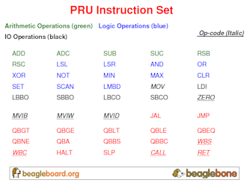
Step 4: Create the PRU Program
Write assembler code to run on the PRU
Create the .bin file for the PRU
May need to update device tree to alter pin modes (later)

Slide 12
Using PRUs – the Painful Way
Note these rules on inline assembly
r2 contains the stack pointer
r3 contains the return address
r14 to r29 are used for argument passing
r14 is used for the return value
r3 to r13 must be saved by the callee
Also Note
R31 – write ‘1’ to bit 5, with some value to bits 0-3
Sends an event to the host

Slide 13
Step 5: Create the Host-side Program
The library functions are documented in the AM335x PRU Linux Application Loader User Guide document
At a minimum the host-side program will
initialize the library
set up the interrupt we want to use
load example.bin from the filesystem into PRU instruction memory and start the PRU
wait until the PRU asserts the interrupt, telling us the program has completed
clean up

Slide 14
Optional: Configure Linux Device Tree
Be aware of pin multiplexing on the chip
Pins need to be set to a different mode to operate at 200MHz, otherwise they will operate at 25MHz
PinMuxUtility_02_05_02_00.zip from TI

Slide 15
Using PRUs – The Easy Way?
Prerequisites
https://github.com/texane/pru_sdk (not strictly required)
CROSS_COMPILE: points to your ARM toolchain
PRU_SDK_DIR: points to the directory where you cloned the repo
Install the PRU C toolchain
Install the PRU loader
Compile & Run a program
Reference:
http://www.embeddedrelated.com/showarticle/603/using-the-c-language-to-program-the-am335x-pru

Slide 16
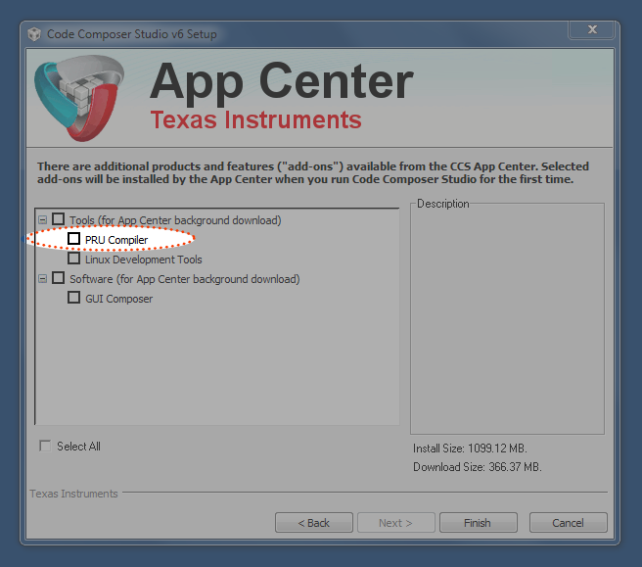
Using PRUs – The Easy Way?
Install CCS OR PRU Code Generation Tools
Enable PRU Compiler during installation

Slide 17
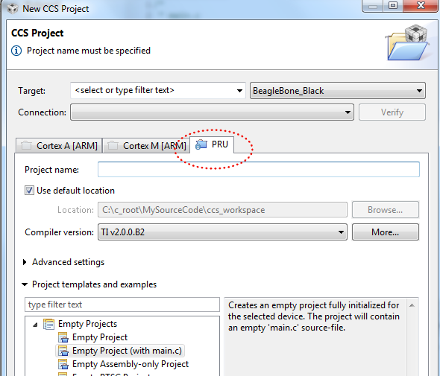
Using PRUs – The Easy Way?
“Project” -> “New CCS project”

Slide 18
Step 2: Install PRU Toolchain
located in the CCS installation directory called pru_2.0.0B2 The pru_2.0.0B2 directory is self contained and can moved
pru_2.0.0B2/bin contains :
clpru: a C compiler
asmpru: an assembler
dispru: a disassembler
lnkpru: a linker
hexpru: an output file generation tool
others tools to have information on binary (ELF) files
TI provides a C standard library in pru_2.0.0B2/lib

Slide 19
Step 3: Install PRU Loader
https://github.com/beagleboard/am335x_pru_package
Loading and execution of PRU binary files:
Starting address will not be 0.
Starting address at symbol called _c_int00
Address specified in prussdrv_exec_program
Modified by prussdrv_exec_program_at
Iwrites the PRU control register address fields
Refer to examples/pruss_c/host_main.c
I put the new library in the pru_sdk repo, and I will submit a patch to the official repository soon.

Slide 20
Step 4: Compile & Run
Example in example/pruss_c
pru_main.c
Floating point multiplication performed by the PRU and stored in shared memory
host_main.c
CPU reads and displays the result
example/pruss_c/build.sh
invoke the compiler to produce object files from PRU C files
link them to produce an ELF file
extract code and data binary from the ELF file
retrieve the start address
compile the CPU program, to be run on the Beagle Bone Black.

Slide 21
What are you left with?
pru_enable-00A0.dtbo: the device tree overlay enabling the PRU
main: the ELF program to be run on the CPU
text.bin: the binary file to initialize the PRU code
data.bin: the binary file to initialize the PRU data
run.sh: load the uio_pruss driver and enable the PRU
These files must be on the BBB
pru_enable-00A0.dtbo goes in /lib/firmware

Slide 22
Boiled Down
Compile the Device Tree Overlay
dtc –O dtb –o BB-BONE-PRU1-00A0.dtbo –b 0 -@ BB-BONE-PRU1-00A0.dts
Copy to /lib/firmware
sudo cp BB-BONE-PRU1-00A0.dtbo /lib/firmware
Load the DTO
echo BB-BONE-PRU1 > $SLOTS
Confirm
cat $SLOTS
Compile the PRU program
pasm –b example.p
Compile the Host program
gcc hostExample.c –o hostExample –lpthread – lprussdrv
Run the Host program
sudo ./hostExample.c
~$ export SLOTS=/sys/devices/bone_capemgr.9/slots
~$ export PINS=/sys/kernel/debug/pinctrl/44e10800.pinmux/pins

Slide 23
Additional Documentation
For the Device Tree
Enabling PWM
PinMux
http://pinmux.tking.org/ - allow you to very quickly see the pinmux value
http://exploringbeaglebone.com/wp-content/uploads/2014/12/Instruction-Set-Sheet.png
Element 14 Forum Thread: BBB - Working with the PRU-ICSS/PRUSSv2
AM335x PRU-ICSS Reference Guide
AM335x PRU Linux Application Loader User Guide
AM335x Technical Reference Guide

Slide 24
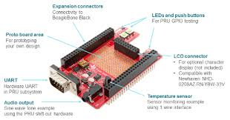
Projects Worth Noting
http://processors.wiki.ti.com/index.php/PRU_Projects
BeaglePilot
PRU Speak
https://github.com/omcaree/bbb-prupwm +24 PWM
PRU BeagleBone Cape
https://github.com/luigif/hcsr04

